Slide 1

Understanding Climate Change with Machine Learning
ML Models for Weather Prediction
Analysis by Jeremy Obach for ClimateWins
15 MAY 2024

Slide 2
Objective
Use Machine learning to help predict the consequences of climate change.
Notes:
Context - data analyst at a European nonprofit organization “ClimateWins”

Slide 3

Proposed Hypotheses
Ongoing climate change is reducing the number of “pleasant weather” days in Europe, year over year.
Extreme weather events are increasing for coastal regions of Europe more than inland regions, year over year.
Weather stations in western Europe will observe a steeper decline in “pleasant weather” days than their counterparts in central and eastern Europe, year over year.
Notes:
With our ML-trained model, we should be able to assess the validity of these hypotheses.
Developing a Hypothesis: 1. Ask. Question, 2. Prelim research, 3.

Slide 4

About the Data
Weather observations from 18 different weather stations across Europe.
BASEL, BELGRADE, BUDAPEST, DEBILT, DUSSELDORF, GDANSK, HEATHROW, KASSEL, LJUBLJANA, MAASTRICHT, MADRID, MUNICH, OSLO, ROMA, STOCKHOLM, TOURS, VALENCIA
Observations measured daily
Cloud cover, wind speed, humidity, pressure, global radiation, precipitation, snow depth, sunshine, mean temperature, min temperature, max temperature
Notes:
Different weather stations may have varying collection standards.

Slide 5
Training the model
Additional dataset “pleasant_wx” used to train ML models on how to categorize days as unpleasant vs pleasant.
Criteria for its categorization worth investigation/scrutiny – determine bias.
Pleasant weather is ultimately subjective

Slide 6
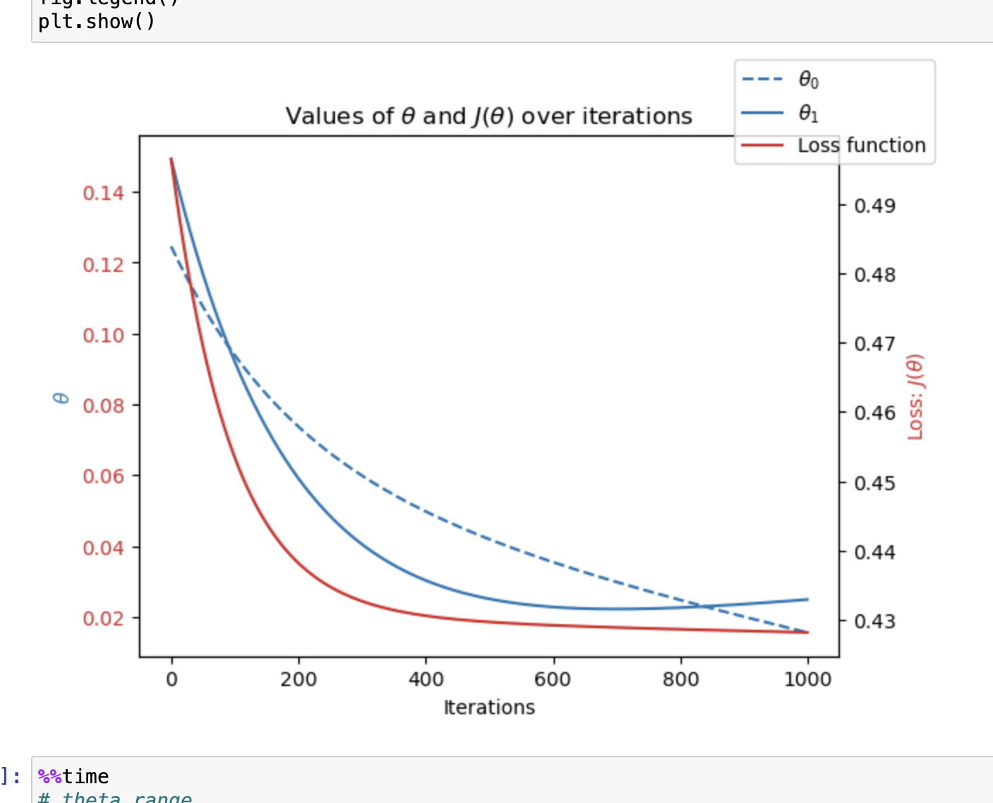
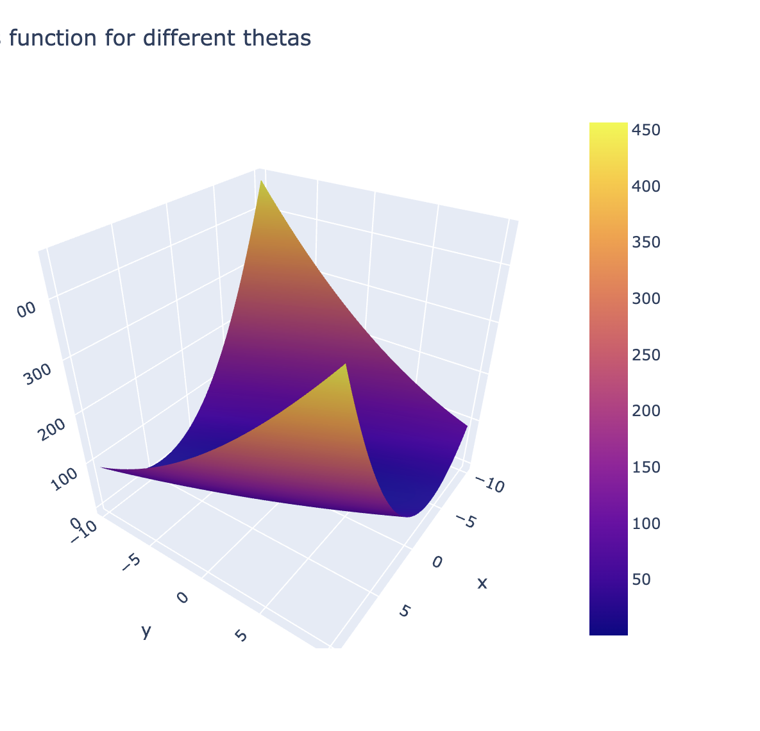
Gradient-Descent Optimization
Used to determine the features of the dataset;
Minimums and Maximums
Local and Global
Investigated city/year combinations:
Ljubliana 1974
Budapest 1989
Madrid 2000

Slide 7
Supervised Learning ML models used
K – Nearest Neighbors
Decision Tree
Artificial Neural Network

Slide 8
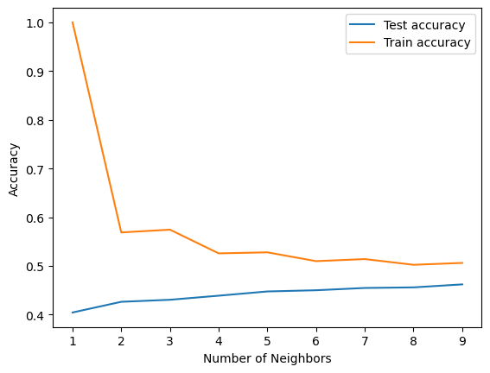
Supervised Learning ML models used
K – Nearest Neighbors ❌
Test Accuracy below 50%
Train Accuracy below 60% at 2 neighbors
Decision Tree ❌
Overfitting
Needs massive pruning
Artificial Neural Network ✅
Utilized 3 hidden layers (100,50,25 nodes) with 1000 iterations.
Yielded 88% train accuracy, 60% test accuracy.

Slide 9
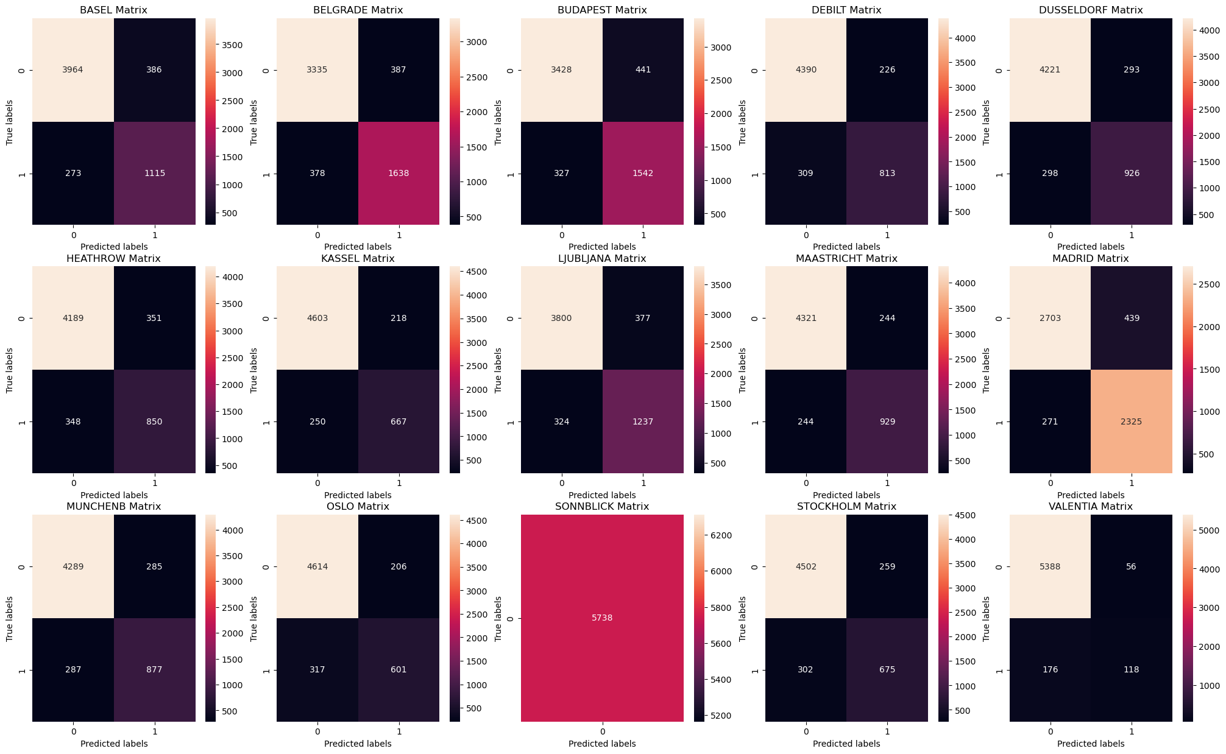
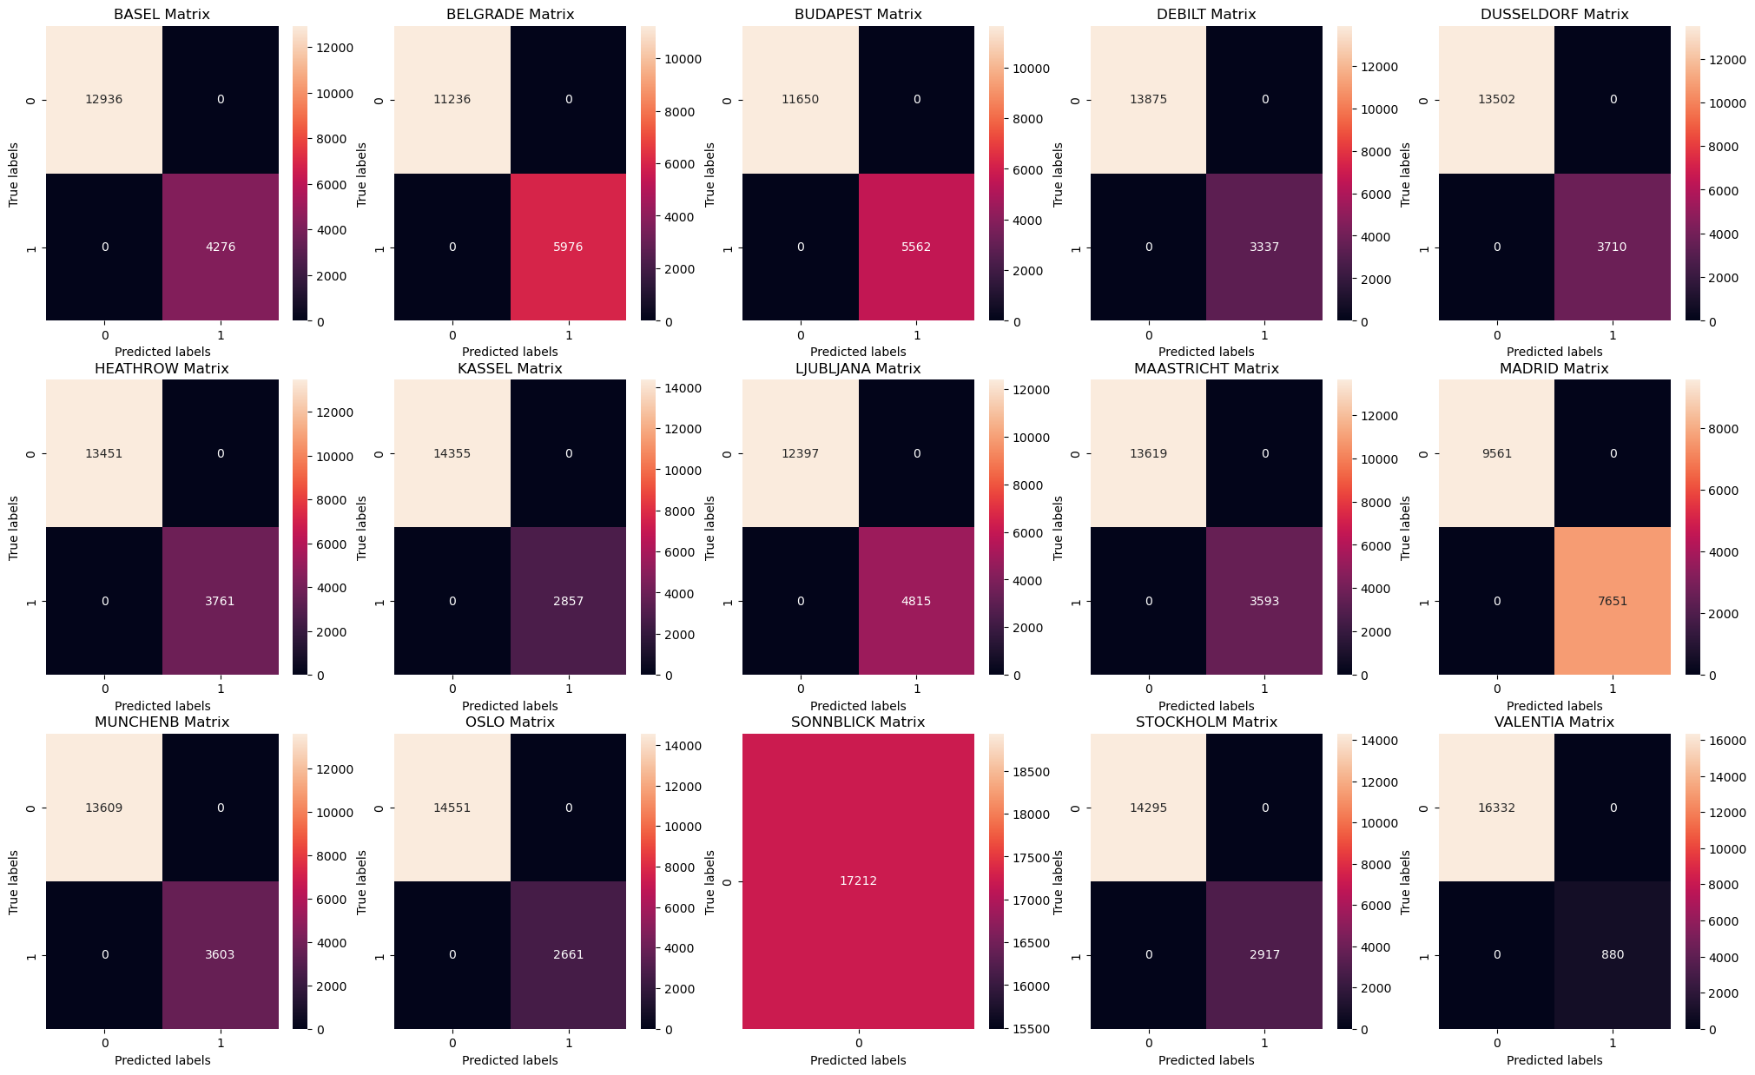
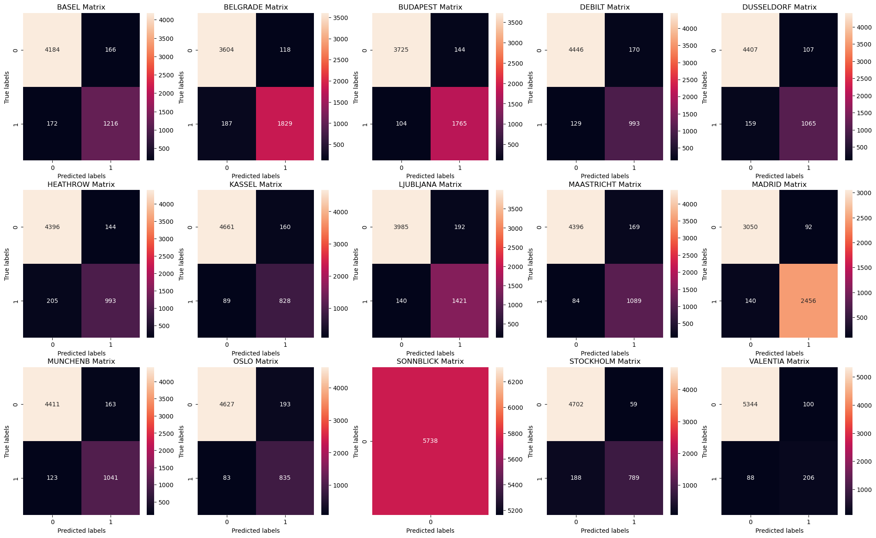
Confusion Matrix comparison
K – Nearest Neighbors
Decision Tree
Artificial Neural Network
Notes:
Confusion matrices. Notice decision tree is 100% accurate. This plus the tree model from last slid indicates massive overfit.

Slide 10
Summary
Hypothesis
Methods chosen
Next Steps
Future Analysis
Notes:
Hypotheses: Ongoing climate change is reducing the number of “pleasant weather” days in Europe, year over year.** main one
Extreme weather events are increasing for coastal regions of Europe more than inland regions, year over year.
Weather stations in western Europe will observe a steeper decline in “pleasant weather” days than their counterparts in central and eastern Europe, year over year.
Methods Chosen - ANN
Next Steps – refine ANN model, project out with model and test for real world accuracy.
Future Analysis –implement Unsupervised ML techniques, random forest, etc from Achievement 2

Slide 11
Questions?
Contact me at Jeremy.Obach@gmail.com
or on LinkedIn –
www.linkedin.com/in/jeremy-obach
See the repository @
https://github.com/jobachone

